Slide 1
Hardware Software Co-Design and Program Modelling
Module 2

Slide 2
Module II
Hardware Software Co-Design and Program Modelling
Fundamental Issues
Computational Models
Data Flow Graph
Control Data Flow Graph
State Machine
Sequential Model
Concurrent Model
Object oriented model
UML

Slide 3
Traditional Embedded System Development Approach
The hardware software partitioning is done at an early stage
Engineers from the software group take care of the software architecture development and implementation, and engineers from the hardware group are responsible for building the hardware required for the product
There is less interaction between the two teams and the development happens either serially or in parallel and once the hardware and software are ready, the integration is performed

Slide 4
Hardware Software Co-design
The term ‘co-design’ implies that hardware and software design be considered concurrent and be done together.
The product requirement is converted into system level needs.
Requirements are specified as functional requirements.
During architectural design phase, system level processing requirement of hardware and software takes place.
Notes:
4

Slide 5
Fundamental Issues in hardware software co design
Selecting the model
Selecting the architecture
Selecting the language
Partitioning system requirements into hardware and software

Slide 6
Selecting the model
Models are used for capturing and describing system characteristics.
Model is a formal system consisting of objects and composition rules.
Selecting a model is hard task
Most designers switch between different models.
Reasons to switch between models
Objective varies in each phase
In specification only functionality is important
In design the components are important, so models which emphasis the structure should be provided.

Slide 7
Selecting the Architecture
Model emphasise only characteristics and not implementation details.
Architecture gives implementation details in terms of number and types of components and the interconnection between them.
Commonly used architectures
Controller architecture (Application Specific)
Datapath architecture (Application Specific)
Complex Instruction set Computing (CISC) (General Purpose)
Reduced Instruction set computing (RISC) (General Purpose)
Very Long Instruction Word Computing (VLIWC) (Parallel Processing)
Single Instruction Multiple Data Set (SIMD) (Parallel Processing)
Multiple Instruction Single Data Set (MIMD) (Parallel Processing)

Slide 8
Controller Architecture
Implements finite state machine model
Uses state register and two combinational circuits
State register holds present state
Combinational circuit implements the logic for the next state and output

Slide 9
Data path Architecture
Suited for implementing data flow graph model
Output is generated as a result of a set of predefined computation on input data
Data path is a channel between input and output
Data path contains registers, counters, register files, memories and ports along with high speed arithmetic units.
Ports connects data path to multiple buses
Arithmetic units are connected in parallel to improve the performance.

Slide 10
Finite State Machine Data Path
FSMD combines controller architecture with data path architecture.
Controller generates control input and data path processes the data.
Data path contains two types of input output ports
One is control port for receiving and sending control signals to and from control units
Second one is I/O port interface with the data path to the outside world for data input and output.

Slide 11
Complex Instruction set Computing
Uses instruction set for doing complex operations
Complex instruction will reduce memory access and program memory size requirements
It requires additional silicon for implementing micro code decoder for decoding instructions.
Data path is also complex

Slide 12
Reduced Instruction Set Architecture
Uses instruction set representing simple operations
Complex operations can be performed using multiple RISC instructions.
Data path contains large number of registers to store data and output
It supports excessive pipelining

Slide 13
Very Long Instruction Word
Architecture supports multiple functional units(ALU, multipliers) in the data path.
Processes one instruction per functional units

Slide 14
Parallel Processing Architecture
Implements multiple concurrent processing elements
Each one is connected with a separate data path containing register and local elements.
Eg: SIMD, MIMD
SIMD:
single instruction is executed in parallel
The scheduling of instruction execution and controlling of each PE is done through single controller
MIMD
Executed different instructions parallelly
It is the basis of multiprocessor system.
Pes in multiprocessor system communicates through shared memory and message passing.

Slide 15
Language Selection
A programming Language captures a ‘Computational Model’ and maps it into architecture
A model can be captured using multiple programming languages like C, C++, C#, Java etc for software implementations and languages like VHDL, System C, Verilog etc for hardware implementations
Certain languages are good in capturing certain computational model. For example, C++ is a good candidate for capturing an object oriented model.
The only pre-requisite in selecting a programming language for capturing a model is that the language should capture the model easily

Slide 16
Partitioning of System Requirements into H/w and S/w
Implementation aspect of a System level Requirement
It may be possible to implement the system requirements in either hardware or software (firmware)
Various hardware software trade-offs like performance, re-usability, effort etc are used for making a decision on the hardware-software partitioning

Slide 17
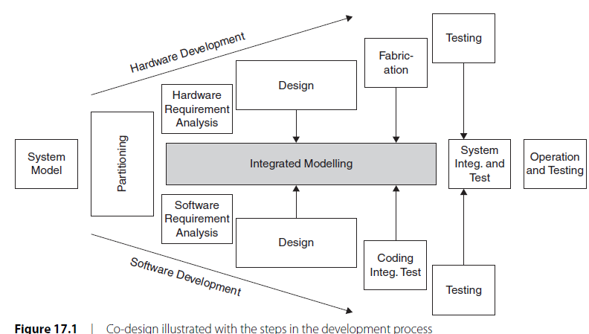
Steps in Co-design
Notes:
17

Slide 18
Computational Models in Embedded Design
Data Flow Graph/ Diagram(DFG) Model
Control/Data Flow Graph
Finite State Machine
Sequential process Model
Concurrent Process Model
Object Oriented Model
UML

Slide 19
Data Flow Graph/ Diagram(DFG) Model
Translates the data processing requirements into a data flow graph
A data driven model in which the program execution is determined by data.
Emphasizes on the data and operations on the data which transforms the input data to output data.
A visual model in which the operation on the data (process) is represented using a block (circle) and data flow is represented using arrows. An inward arrow to the process (circle) represents input data and an outward arrow from the process (circle) represents output data in DFG notation
Best suited for modeling Embedded systems which are computational intensive (like DSP applications) .
Notes:
19

Slide 20
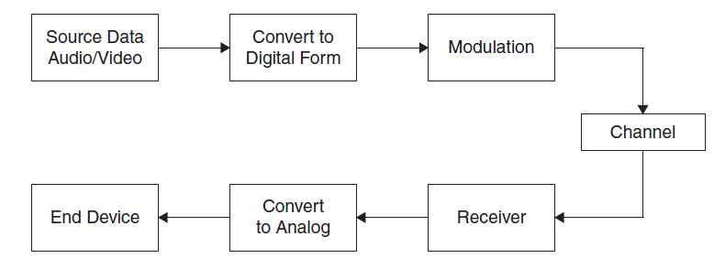


Notes:
20

Slide 21
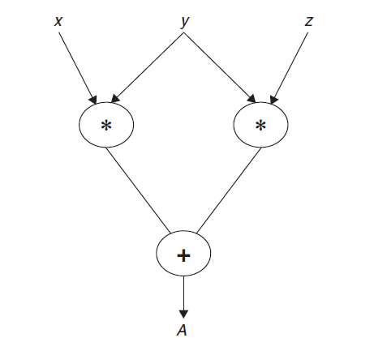

Notes:
21

Slide 22
A DFG model is acyclic if it doesn’t contains multiple values for input variables and multiple values for output for the same input.
A DFG model translate program as a single sequence of execution.

Slide 23
Control/Data Flow Graph
Translates the data processing requirements into a data flow graph
Model applications involving conditional program execution
Contains both data operations and control operations
Uses Data Flow Graph (DFG) as element and conditional (constructs) as decision makers.
CDFG contains both data flow nodes and decision nodes, whereas DFG contains only data flow nodes
A visual model in which the operation on the data (process) is represented using a block (circle) and data flow is represented using arrows. An inward arrow to the process (circle) represents input data and an outward arrow from the process (circle) represents output data in DFG notation.
Notes:
23

Slide 24
The control node is represented by a ‘Diamond’ block which is the decision making element in a normal flow chart based design
Translates the requirement, which is modeled to a concurrent process model
The decision on which process is to be executed is determined by the control node
Capturing of image and storing it in the format selected (bmp, jpg, tiff, etc.) in a digital camera is a typical example of an application that can be modeled with CDFG

Slide 25
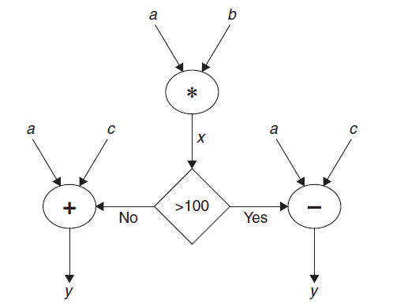

Notes:
25

Slide 26
State Machine Model
Used for modeling reactive or event driven modeling system whose processing behavior is dependent on state transition system.
Based on ‘States’ and ‘State Transition’
Describes the system behavior with ‘States’, ‘Events’, ‘Actions’ and ‘Transitions’
State is a representation of a current situation.
An event is an input to the state. The event acts as stimuli for state transition.
Transition is the movement from one state to another.
Action is an activity to be performed by the state machine.

Slide 27
A Finite State Machine (FSM) Model is one in which the number of states are finite.
In other words the system is described using a finite number of possible states
Most of the time State Machine model translates the requirements into sequence driven program

Slide 28
Example: Seat Belt Warning in automotive
When the vehicle ignition is turned on and the seat belt is not fastened within 10 seconds of ignition ON, the system generates an alarm signal for 5 seconds.
The alarm is turned off when the alarm time expires or if the driver fastens the belt or if the alarm ignition switch is turned off whichever happens first.
States are marked as circles and events are marked with arrows between the states.

Slide 29
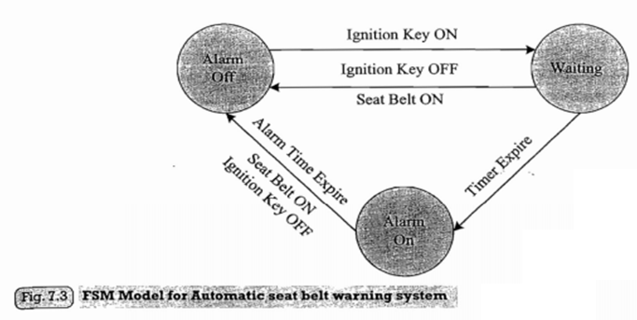

Slide 30
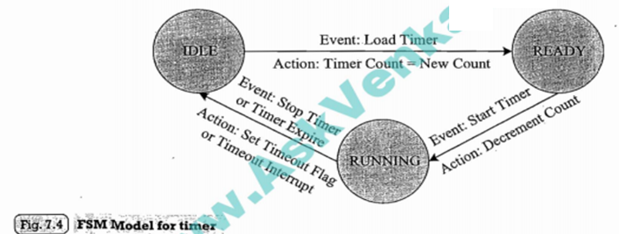
Example : Timer

Slide 31
Exercise:
Design a tea/coffee vending machine based on FSM model

Slide 32
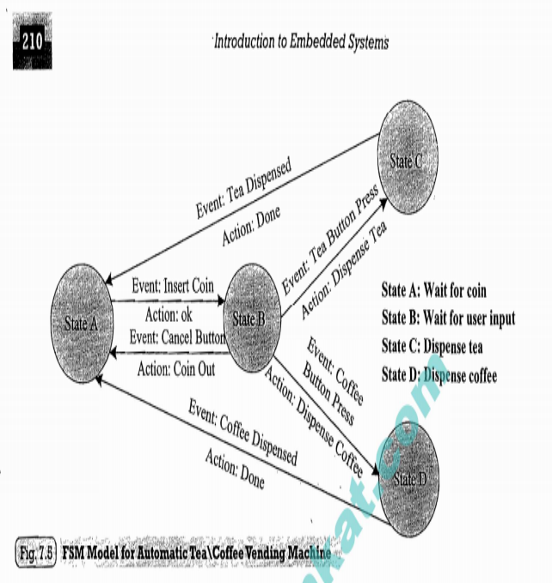

Slide 33
Example 3:
Coin operated Telephone system.

Slide 34
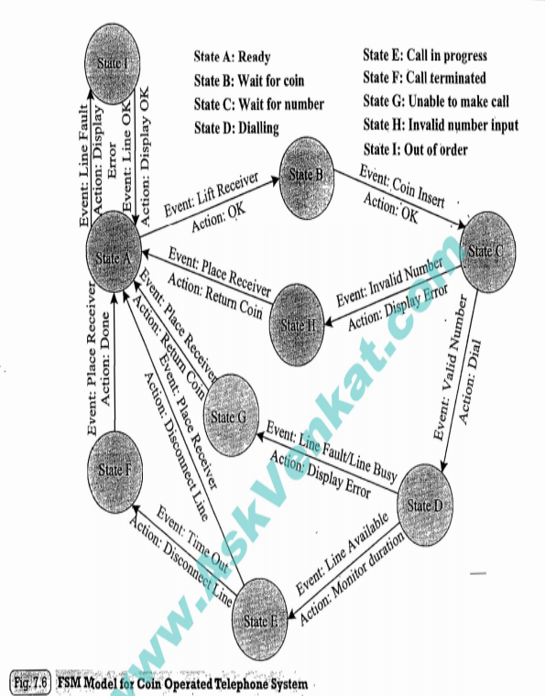

Slide 35
Sequential Process Model
In this models the function or processing requirements are executed in sequential order.
Similar to procedural programming
FSM and flow charts are tools used for modelling
FSM represents states and transitions and flow charts represents sequence of execution flow.

Slide 36
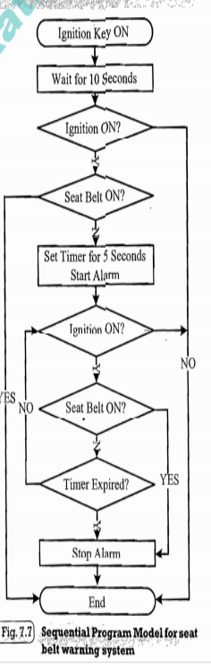
Sequential Process Model example

Slide 37
Concurrent Process Model
It models concurrently executing process.
Sequential execution leads to poor processor utilization.
If the task is split into multiple tasks, CPU utilization can be improved as one process goes into waiting stage another subtask can enter into execution.
But it creates overheads in task synchronization, scheduling and communication.

Slide 38
Example for CPM(Seat Belt Warning System)
Task is split into
Timer task for waiting 10 seconds
Task for checking the ignition key status
Task for checking the seat belt status
Task for starting and stopping the alarm
Alarm timer task for waiting for 5 seconds.

Slide 39
Among these we cannot execute them randomly or sequentially.
We need to synchronize the execution through some mechanism.
We need to start the alarm only after the expiration of 10 seconds and only if the ignition key is ON and seat belt is OFF.
Wait_timer_expires event is associated with timer task event.
It is set when the timer expires.

Slide 40
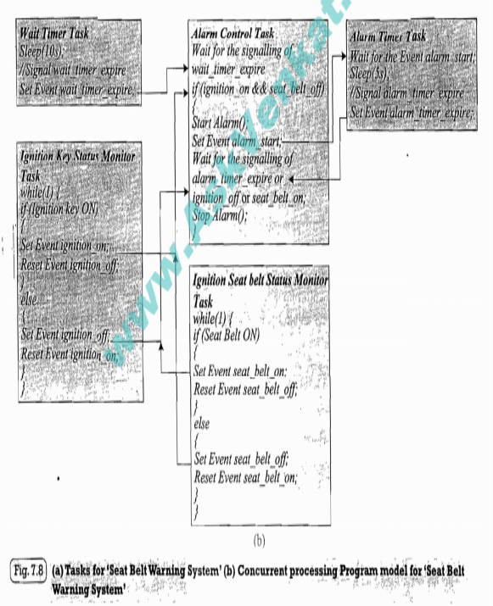
Concurrent Process Model

Slide 41
Object oriented model
It divides complex software requirements into simple well defined pieces called objects.
This model brings reusability, productivity and maintainability in system design.
Object is an entity which models a particular piece in the system
Each object is characterised by a unique set of behaviours and state.
Class is abstract representation of a set of objects or called the blue print of an object.

Slide 42
A class represent state of an object through member variables and object behaviour through member functions.
Member variables and functions can be public, private or protected depending on its accessibility in other classes.
These features brings abstraction and protection.

Slide 43
UML
Unified Modelling Language is a visual modelling language for object oriented design.
UML helps in all phases of system design through a set of unique diagrams for requirement capturing, designing and deployment.

Slide 44
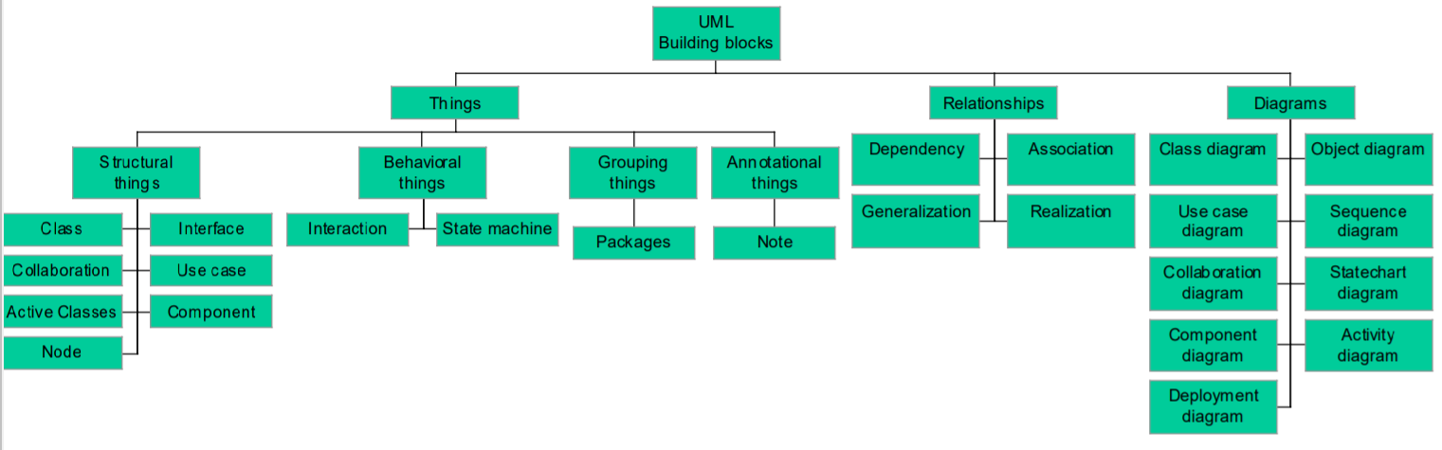
UML Building Blocks

Slide 45
Four Kinds of Things
Structural
Behavioural
Grouping
Annotational

Slide 46
Structural things
Represents the static part of UML model
Also known as classifiers.

Slide 47
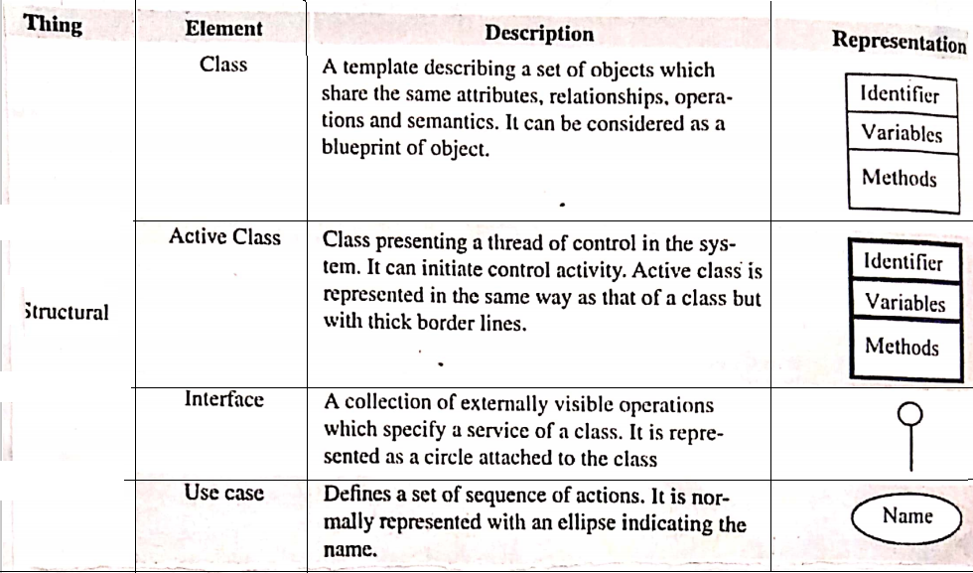
Structural things

Slide 48
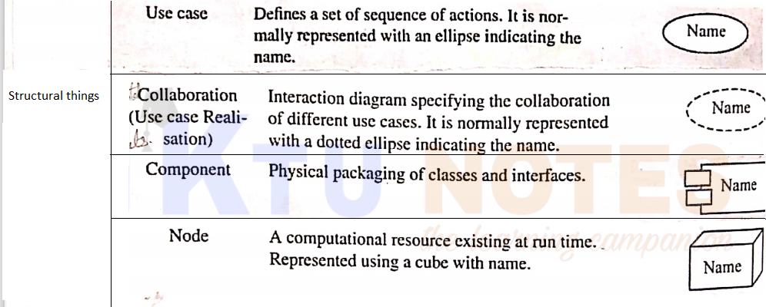
Structural things

Slide 49
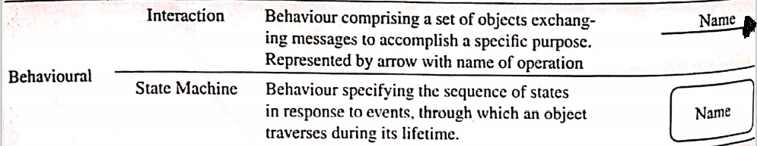
Behavioural Things
Represents the dynamic part of UML model
Interaction, state machine and activity are behavioural things.

Slide 50

Grouping things
Represents organizational parts in UML model
Packages and sub systems are groping things.

Slide 51
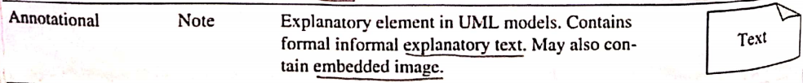
Annotational things
It is the explanatory part of UML model.

Slide 52
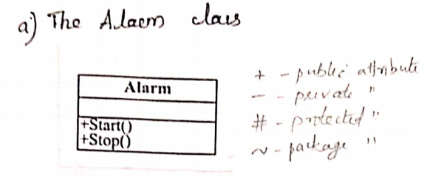
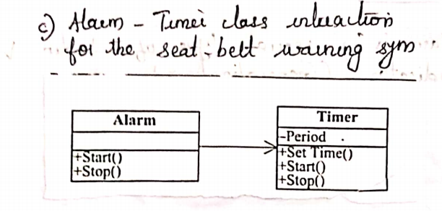
Example

Slide 53
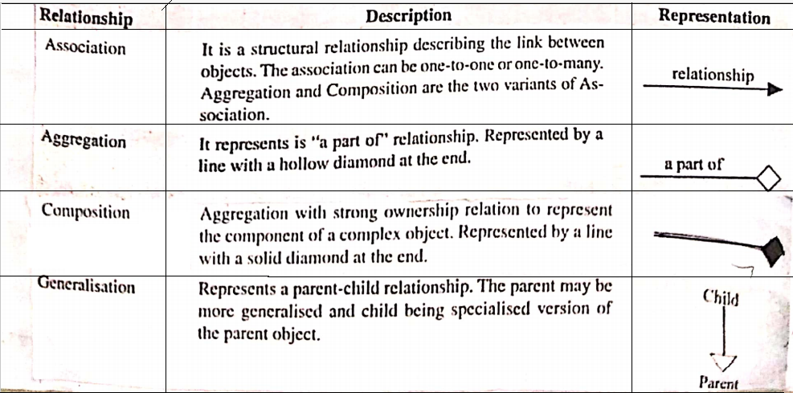
Relationships
It represents the relationship between the UML elements.

Slide 54
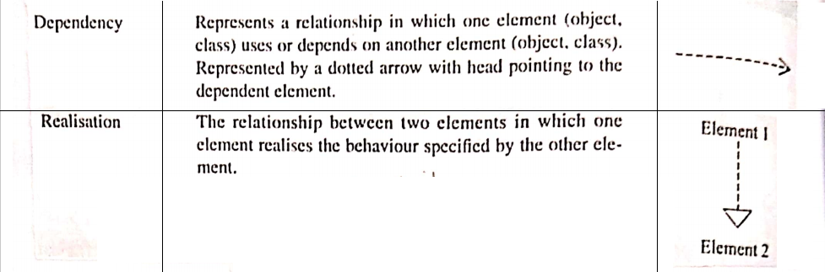
Relationship

Slide 55
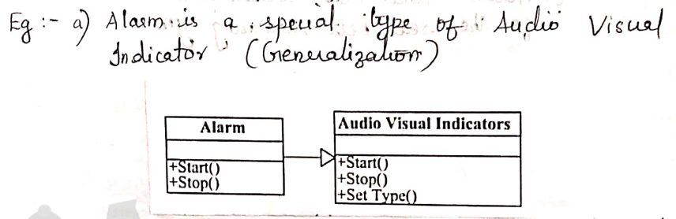
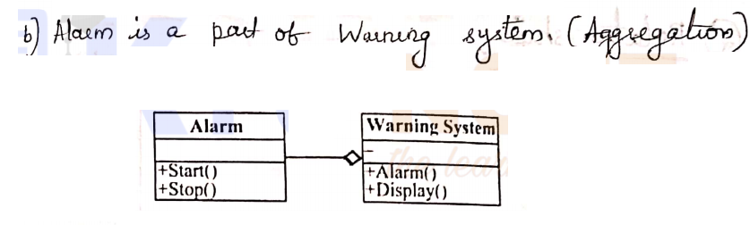
Example

Slide 56
UML Diagrams
UML diagram gives a pictorial representation of static aspects, behavioural aspects and management of different modules of the system.
They are grouped into static and behavioural diagrams.

Slide 57
Static diagrams
Represents the statistical aspects of the system.
Different static diagrams are object diagram, class diagram, component diagram, package diagram and deployment diagram.

Slide 58
Different static diagrams
Diagram | Description
Object diagram | Gives a pictorial representation of a set of objects and their relationships. Represents the structural organization between objects
Class diagram | Gives a pictorial representation of a set of classes, their interfaces, the collaborations, interactions and relationship between classes. It captures static design of the system.
Component diagram | It is pictorial representation of the implementation view of the system. It comprises components(physical packaging of classes and interfaces), relationships, and association among components.
Deployment diagrams | It is pictorial representation of the configuration of runtime processing nodes and the components associated with them.

Slide 59
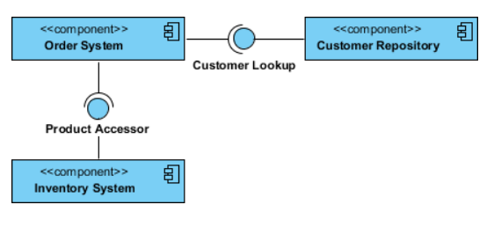
Example of component diagram

Slide 60
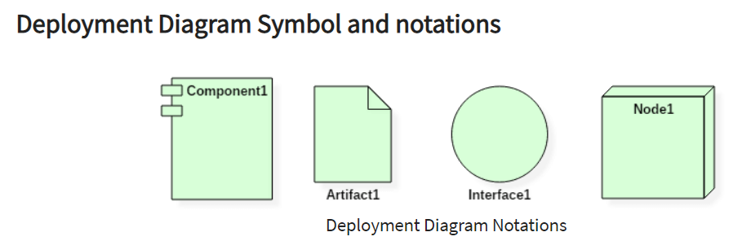
Deployment diagram
Deployment diagrams are used with the sole purpose of describing how software is deployed into the hardware system.
It visualizes how software interacts with the hardware to execute the complete functionality.
It is used to describe software to hardware interaction

Slide 61
Notations of deployment diagram
A node: Node is a computational resource upon which artifacts are deployed for execution. A node is a physical thing that can execute one or more artifacts.
A component
An artifact: An artifact represents the specification of a concrete real-world entity related to software development.
Examples : Source files, Executable files, Database tables
An interface

Slide 62
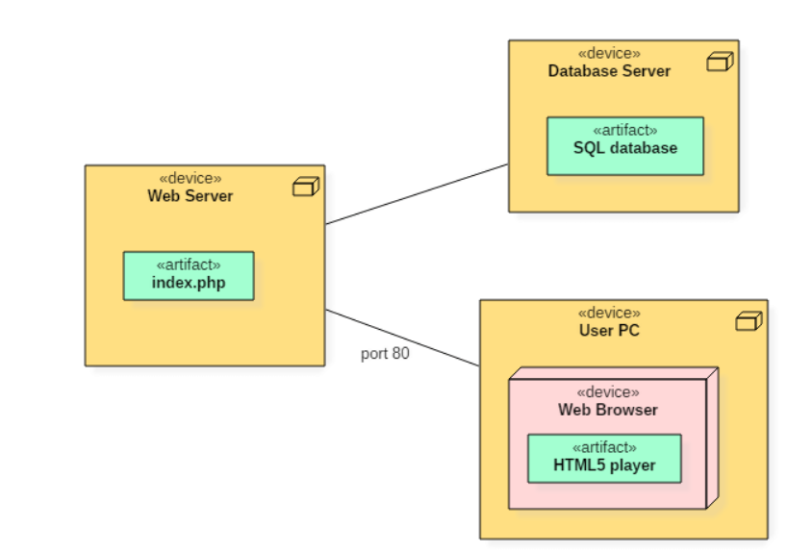
Example
Following deployment diagram represents the working of HTML5 video player in the browser:

Slide 63
Behavioural Diagram
These diagram represents the dynamic aspects of the system.
Use case diagram, sequence diagram, collaboration diagram, state chart diagram, and activity diagram etc. are behavioural diagram.

Slide 64
Diagram | Description
Use case diagram | It is used for describing the system functionality as seen by the user. Useful for capturing system requirements. It comprises use cases, actors(users), and the relationship between them. Actor is one who interacts with the system. Use case is a sequence of interaction between actors and system.
Sequence diagram | It is a type of interaction between diagram representing object interaction with respect to time. It emphasise on the time ordering of messages. Suitable for interaction modelling of real world system.
Collaboration diagram | It represents the object interactions and their linking with others. It gives emphasis to the structural organization of objects that sends and receive messages.

Slide 65
Diagram | Description
State chart diagram | A diagram showing states, transition, events and activities Suitable for modelling reactive systems
Activity diagram | It shows activity transition It emphasis flow of control among objects.

Slide 66
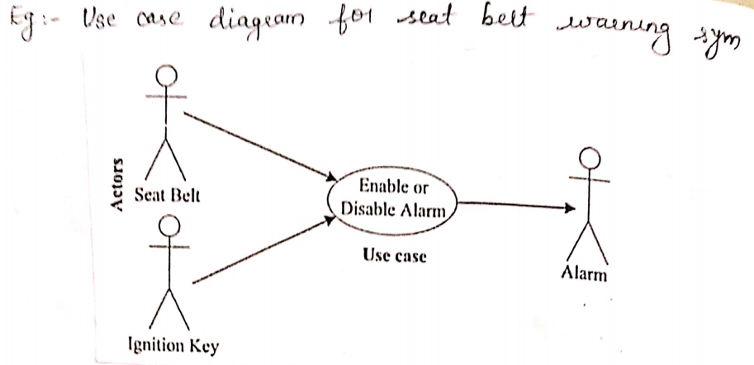
Use case diagram example

Slide 67
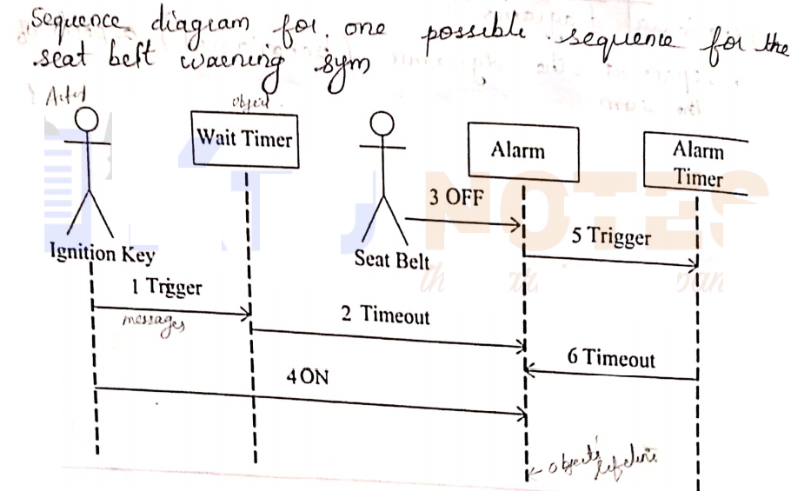
Sequence diagram Example

Slide 68
UML Tools
Used for building UML based models
Available from different vendors
Commercial and open source tools are available

Slide 69
